Slide 1
PREDICTING DIABETES RISK WITH MACHINE LEARNING.
An analysis of the PIMA Indians diabetes dataset
Group Two
NAMES | REG NO.
TURYA JOHN STEVEN | 2023-B071-21285
WALWASA NATHAN ABEL | 2023-B071-21203
SSEMANDA JONATHAN | 2023-B071-22335
NALULE CATHERINE | 2023-B071-22337
NSUBUGA NICHOLAS PAUL | 2023-B071-22173

Slide 2
Overview
Dataset.
  PIMA Indians diabetes dataset
Objective.
  To build and evaluate a machine learning model to predict the onset of diabetes based on diagnostic health measurements.
Methodology.
  Data cleaning and preprocessing. Handled missing values and normalize data.
  Exploratory Data Analysis (EDA). Visualized key features and their relationships.

Slide 3
Continuation.
Methodology.
  Feature engineering. Created new features to improve model performance i.e.
    Categorical Feature Example; BMI_Category (e.g., 'Underweight', 'Normal', 'Overweight', 'Obese').
    Interaction Feature Example; Glucose_x_BMI (multiplying a patient's glucose level by their BMI).
  Modeling. Trained and evaluated Logistic Regression and Naïve Bayes models.
  Reflection. Interpreted results in a clinical context.

Slide 4
Data cleaning.
Problem. Key medical data like Glucose, Blood Pressure, and BMI contained impossible '0' values.
Solution.
  Replaced Zeros. Converted all invalid '0's to NaN (missing values).
  Imputation. Filled missing values with the median of each column. This is a robust method that is not sensitive to outliers.
  Normalization. Scaled all features to a standard range to ensure fair comparison and stable model training.
Outcome. A clean, complete dataset ready for analysis and modeling.

Slide 5
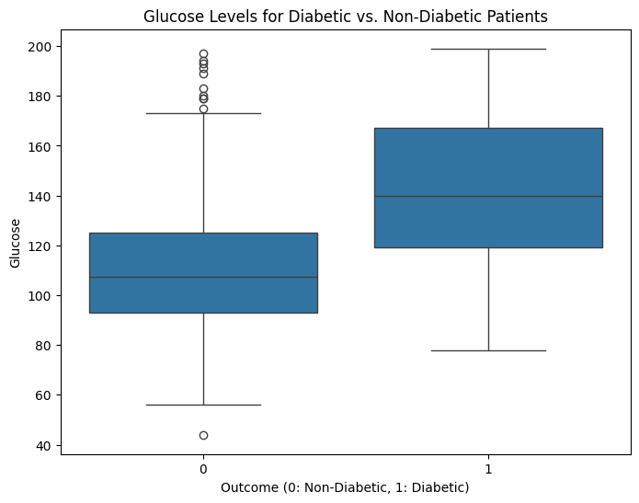
Key insights from exploratory analysis (EDA)

Slide 6
Continuation
Glucose is the strongest indicator.
  The boxplot clearly shows that patients with diabetes have significantly higher glucose levels.
  A t-test confirmed this difference is statistically significant (p < 0.001).
High correlation with outcome.
  The correlation heatmap showed that glucose, BMI, and age have the strongest positive correlation with a diabetes diagnosis.
Dataset frequency.
  The 95% confidence interval for diabetes prevalence in this dataset is approximately (31.6%, 38.3%).

Slide 7
Model training and evaluation
Models trained.
  Logistic regression. A reliable and interpretable linear model.
  Naïve bayes. A simple yet effective probabilistic classifier.
Evaluation method.
  5-fold cross-validation. This technique provides a robust measure of model performance by training and testing on 5 different subsets of the data. This helps ensure our results are not due to a single lucky train/test split.

Slide 8
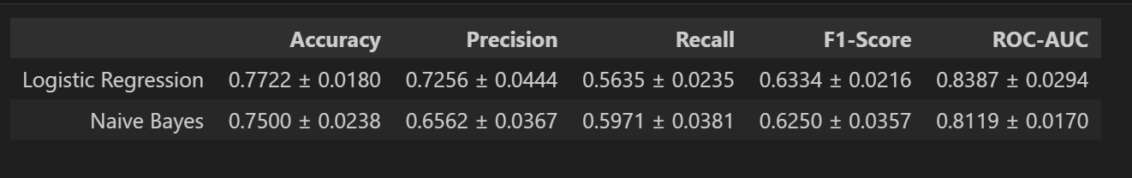
Model performance results.

Slide 9
Continuation
Key observation.
  Both models perform similarly, with logistic regression having a slight edge in overall accuracy and precision.
  Naïve bayes has a slightly better recall.

Slide 10
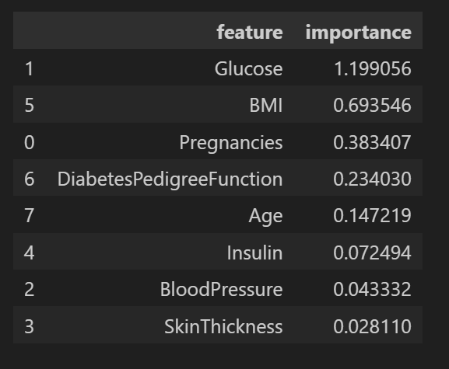
Features that are most important.

Slide 11
Continuation
Conclusion.
  As revealed by the logistic regression model, glucose is by far the most important predictive feature.
  BMI and Age (from EDA) are also highly influential. This aligns perfectly with clinical knowledge.

Slide 12
Recall verses precision in a clinical context
Which error is worse?
  False positive (Low precision). Telling a healthy patient they might have diabetes. (leads to extra testing, anxiety).
  False negative (low recall). Telling a diabetic patient that they are healthy. (leads to no treatment and severe health complications).
Ethical implications.
  A missed diagnosis (false negative) is far more dangerous.
  Therefore, for a medical screening tool, recall is the most critical metric. We want to identify as many true positive cases as possible.
Model choice.
  Naïve bayes has a slightly higher Recall (0.597) than logistic regression (0.564).
  It better balances the need to minimize missed diagnoses, making it a slightly better choice in this specific clinical context despite its lower overall accuracy.

Slide 13
Conclusion
Conclusions.
  We can predict diabetes with reasonable accuracy (around 75-77%) using standard clinical data.
  Glucose level is the dominant predictive factor.
  In this context, the naive bayes model is slightly preferred because it achieves a better Recall, which is crucial for minimizing missed diagnoses.
Suggestions for improvement.
  Collect more data. Incorporate features like family history, diet, and exercise levels.
  Use advanced models: Explore models like Random Forest or Gradient Boosting, which may capture more complex patterns.
  Tune for recall: Use techniques to optimize the models specifically for higher recall, accepting a potential trade-off in precision.

